Slide 1
Secure Wireless and Software Defined Networks
Saim Ghafoor
Lecture 3-1
SDN Controllers and protocols

Slide 2
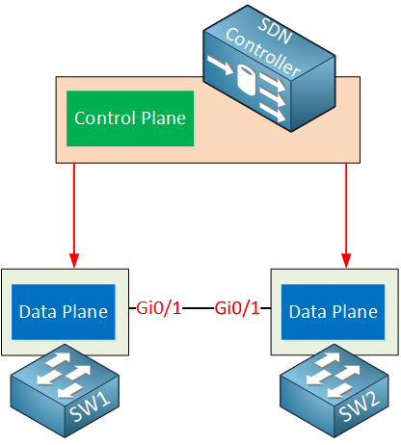
SDN Controllers
A Software-Defined Networking (SDN) controller is a central component of SDN architecture. It provides control over the network elements
In networking, there is the Management Plane, Control Plane and Data Plane. An SDN controller provides Management Plane and Control Plane functionalities for the network elements in the domain it manages.
An SDN controller, based on network information and a set of predefined rules and policies, manages the network elements and configures (“programs”) the Data Plane.

Slide 3
Benefits
It allows more efficient network management
Changes in network configuration can be applied from a central location.
Other benefits of deploying SDN Controllers
Provides a single, unified interface allowing network administrators and external applications (e.g. orchestration platforms) to interact (configure and manage) with the network
Increases the level of network automation (an SDN controller can automate network management and configuration tasks)
Optimizes usage of resources (can optimize packet paths to achieve better network efficiency)
Increases network resilience (e.g. faster reaction to changes in the network, building alternative paths)
Possible management of physical network devices and software based network elements

Slide 4
(using API, Northbound) an SDN controller translates the application’s layer requirements (e.g. high-level description of the network configuration) into a configuration specific to the supported network elements.
SDN controllers can manage both physical network devices and software components that execute network functions.

Slide 5
The main functions of an SDN controller include:
Managing the flow of data in the managed network
Providing an API for applications and other components (e.g. orchestration platforms) to interact with the network
Providing visibility into the network, allows monitoring of network performance and detection of problems
Automating network management tasks, such as provisioning new network elements and reconfiguring network paths

Slide 6
Controller working
An SDN controller is a logically centralised entity typically implemented as a software application running on a server or cluster of servers.
It communicates with various network devices (such as switches and routers) and/or software components (realising network functions) through its southbound interfaces, e.g. an API and/or standardised/proprietary protocols.
Examples of protocols include OpenFlow, Open vSwitch (OVS) database, NETCONF, P4RT (P4Runtime - protocol-independent runtime APIs for a P4-defined or P4-described data plane) and XMPP (Juniper Contrail).

Slide 7
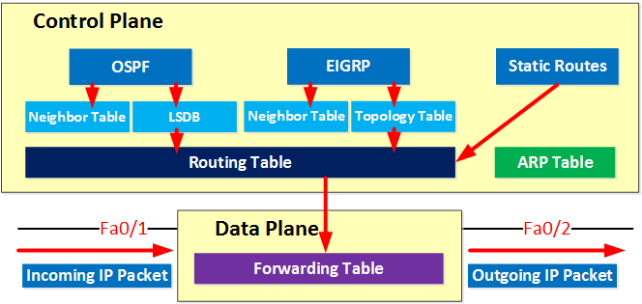

Slide 8
Southbound interfaces
The SDN controller has to communicate with our network devices in order to program the data plane. This is done through the southbound interface. This is not a physical interface but a software interface, often an API (Application Programming Interface).
An API is a software interface that allows an application to give access to other applications by using pre-defined functions and data structures.
Some popular southbound interfaces are:
OpenFlow: this is probably the most popular SBI at the moment; it’s an open source protocol from the Open Networking Foundation. There are quite a few network devices and SDN controllers that support OpenFlow.
Cisco OpFlex: This is Cisco’s answer to OpenFlow. It’s also an open source protocol which has been submitted to the IETF for standardisation.
CLI: Cisco offers APIC-EM, which is an SDN solution for the current generation of routers and switches. It uses protocols that are available on current-generation hardware, like telnet, SSH, and SNMP. (EOL Feb 2024)

Slide 9
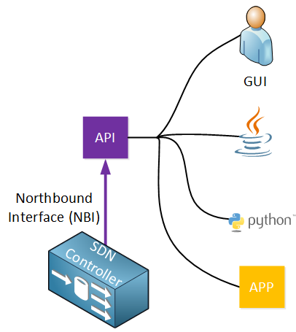
Northbound interface
Used to access the SDN controller itself.
This allows a network administrator to access the SDN to configure it or to retrieve information from it.
This could be done through a GUI, but it also offers an API which allows other applications access to the SDN controller.
Scripts can be used to automate network administration.
Here are some examples:
List information from all network devices in your network.
Show the status of all physical interfaces in the network.
Add a new VLAN on all your switches.
Show the topology of your entire network.
Automatically configure IP addresses, routing, and access lists when a new virtual machine is created.

Slide 10
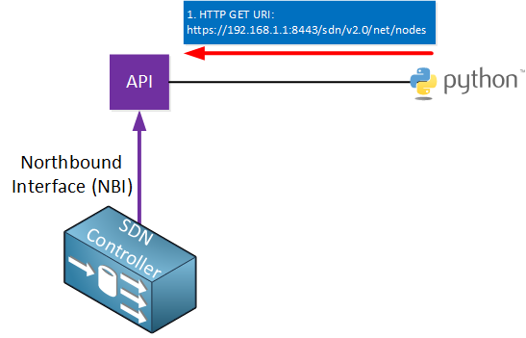
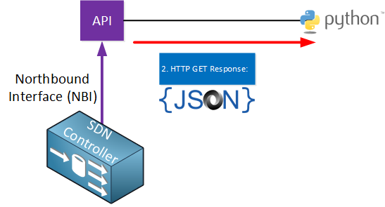
REST API
SDN controllers typically use a REST API (Representational State Transfer).
The REST API uses HTTP messages to send and receive information between the SDN controller and another application. It uses the same HTTP messages that you use when you browse a webpage on the Internet or when you enter a contact form online:
HTTP GET: used when we want to retrieve information.
HTTP POST/PUT: used when we want to upload or update information.
When the SDN controller receives the HTTP GET request, it will reply with an HTTP GET response with the information that was requested. This information is delivered in a common data format. The two most used data formats are:
JSON (JavaScript Object Notation)
XML (eXtensible Markup Language)

Slide 11
Vendor and open-source SDN controllers
On the market, there are both proprietary and open-source SDN controllers. Below are a few examples of each.
Vendors offering SDN controllers:
Cisco
Juniper Networks
VMware
Nokia
Open-source SDN controller options:
OpenDaylight
ONOS (Open Network Operating System)
Tungsten Fabric (open-source version of Juniper Contrail)

Slide 12
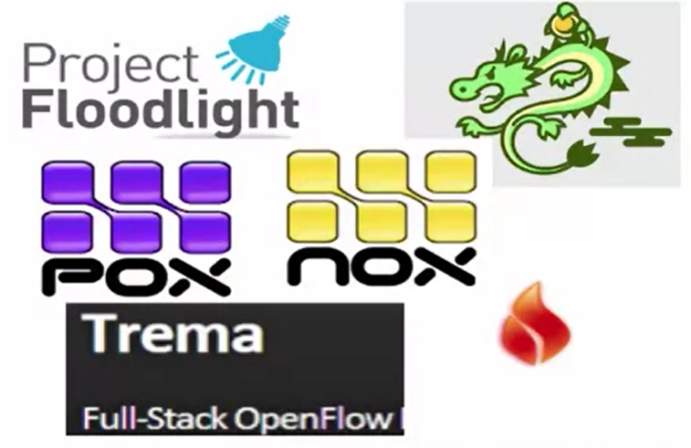
Different SDN controllers available
NOX/POX
Ryu
Floodlight
OpenDaylight
Pyretic
Frenetic
Procera
RouteFlow
Trema

Slide 13
NOX: Overview
www.noxrepo.org
First Generation OpenFlow Controller
Open Source, Stable Widely Used
Two flavours of NOX
NOX classic: c++/Python. No longer supported
NOX (the new NOX)
C++ only
Fast, clear codebase
Well maintained and supported
NoX Charactersitics
Users implement control in C++
Supports OpenFlow v1.0
fork of NOX (CPqD) Supports 1.1., 1.2, 1.3
Programming model
Controller registers for events
Programmer writes event handler
When to use NOX
You know C++
You are willing to use low-level facilities and semantic of OpenFLow
You need good performance

Slide 14
POX: Overview
NOX in Python
Supports OpenFlow v1.0 only
Advantages
Widely used, maintained, supported
Relatively easy to read and write code
Disadvantages: Performance
Will be used in the course (POX or NOX)
When to use POX?
If you know (or can learn) python and are not concerned about the controller performance
Rapid prototyping and experimentation
Research, experimentation, demonstration
Learning concepts

Slide 15
Ryu
Open-source python controller
Supports OpenFlow 1.0, 1.2, 1.3, 1.4, Nicira extensions
Works with OpenStack
Aims to be an Operating System for SDN
Advantages:
OpenStack Integration, OpenFlow 1.2, 1.3, 1.4
Disadvantage: Performance compared to commercial-grade controllers

Slide 16
Floodlight
Open-source Java controller
Supports Open Flow 1.0
Fork from the beacon Java OpenFlow controller
Maintained by Big Switch Networks
Advantages
Good documentation
Integration with REST API
Production level, openstack/Multi-Tenant cloud
Disadvantages: Steep Learning Curve
When to use Floodlight?
You know Java
You need production level performance and support
You will use the RESP API to interact with the controller

Slide 17
Open Daylight
Goal: Common industry supported platform
Robust, extensible open source codebase
Common abstractions for northbound capabilities
Advantages:
Industry acceptance, integration with OpenStack, cloud applications etc
Disadvantages
Complex, steep learning curve
Another similar controller: HP VAN (both are based on BEACON controller)
When to use?
You know Java
You need production-level performance and support
You need support with cloud applications, OpenStack etc.
You need modular functions (plugging different types of functionalities in the same controller)
You need apps already supported by vendors (will discuss)

Slide 18
Other evolving existing controllers: LoxiGen
Generated OF Language-specific bindings
Input: Wire-protocol descriptions
Output: Protocol-specific bindings for different controllers
Generated OpenFlow v1.0-1.3.1+ bindings
C: for indigo
Java: for FloodLight
Python: for OFTest
Wireshark/Lua

Slide 19
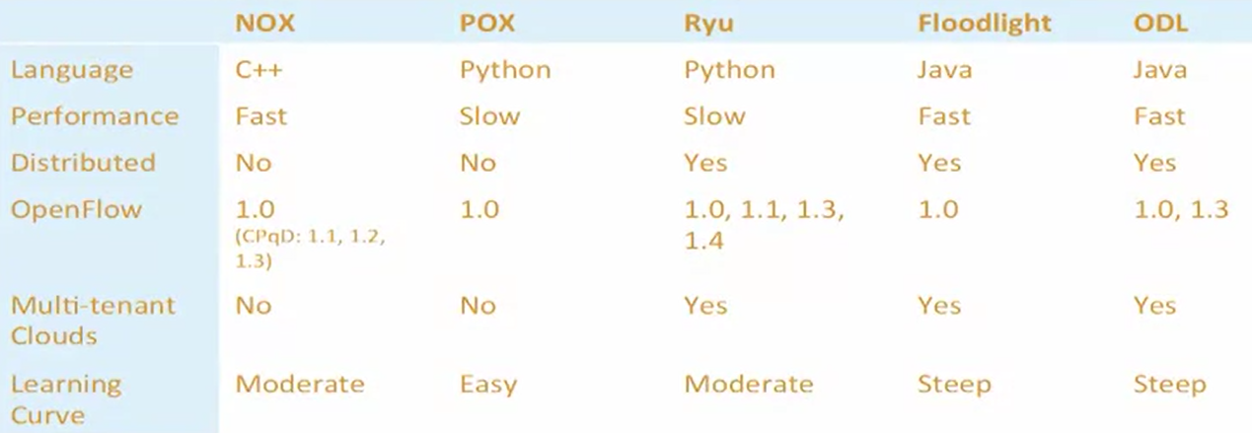
Summary
Choice of controller depends on needs, language etc
Southbound (floodlight provide wide range of these APIs)
Northbound APIs (management, policy)

Slide 20
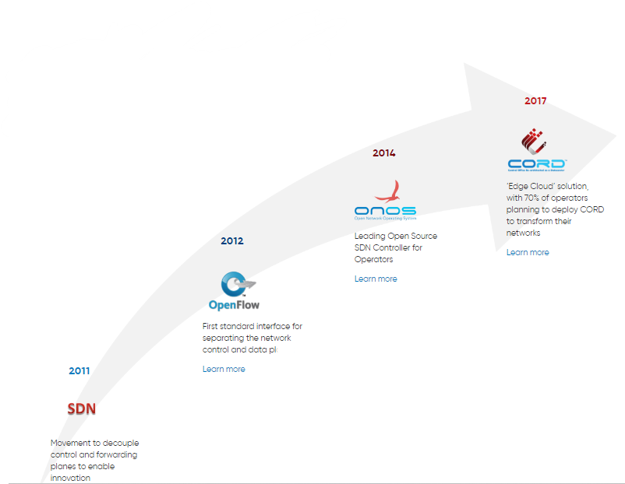
SDN standard
https://sdn.ieee.org/standardization
https://opennetworking.org/software-defined-standards/specifications/

Slide 21
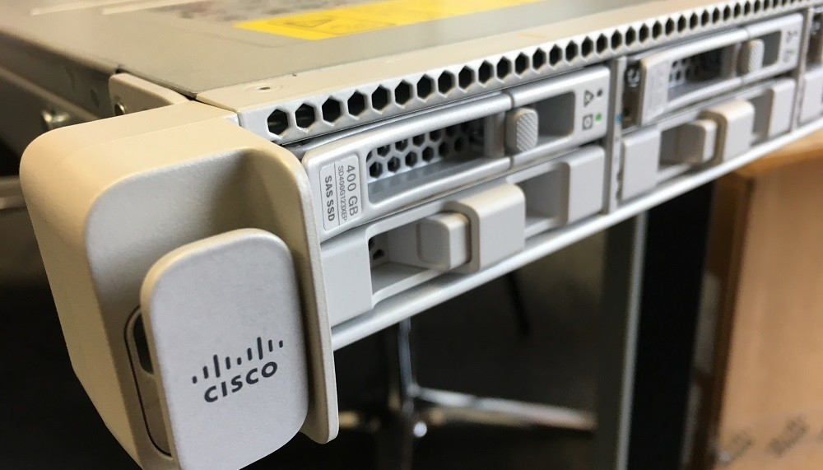
Cisco – APIC (ACI)
SDN Controller: Cisco Application Policy Infrastructure Controller (APIC)
Role: Central controller for ACI fabric, policy model, endpoint registry, automation, telemetry.
Form: Hardware appliance (APIC-M4 / L4 servers) or VM form for labs.
Links:
https://www.cisco.com/c/en/us/products/collateral/cloud-systems-management/application-policy-infrastructure-controller-apic/datasheet-c78-739715.html
https://www.cisco.com/c/en/us/td/docs/switches/datacenter/aci/apic/server/m4-l4-server/APIC-M4-L4-Server/m_overview.html
https://www.youtube.com/watch?v=IUCI-hLzTTM
https://www.youtube.com/watch?v=2YeVFPU8Lug

Slide 22
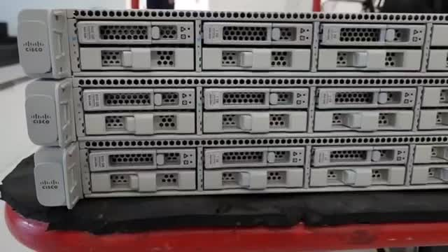


Slide 23
Juniper – Contrail / CN2
SDN Controller: Contrail Controller (now Cloud-Native Contrail Networking – CN2).
Role: Overlay networking (VXLAN, MPLS), control plane, analytics, automation for multicloud and Kubernetes.
Form: Software-only, deployed as VMs or containers (no proprietary hardware).
Links:
https://www.juniper.net/us/en/products/sdn-and-orchestration/contrail/cloud-native-contrail-networking-datasheet.html
https://www.juniper.net/content/dam/www/assets/datasheets/us/en/sdn-management-operations/cloud-native-contrail-networking-datasheet.pdf
https://www.juniper.net/us/en/products/sdn-and-orchestration.html
https://www.juniper.net/content/dam/www/assets/white-papers/us/en/contrail-architecture.pdf

Slide 24
VMware – NSX (NSX Manager / Controllers)
SDN Controller:
NSX-T Manager (cluster of appliances)
Earlier NSX-V had a dedicated “NSX Controller Cluster” (3 VMs).
Role: Provides centralized network control plane, policy, routing, firewall rules, overlays (Geneve, VXLAN).
Form: Virtual appliances (VMs, OVAs).
Links:
https://www.vmware.com/docs/vmware-nsx-datasheet
NSX Manager / Appliances Install Guide
https://www.vmware.com/products/cloud-infrastructure/nsx
https://www.virtualizationhowto.com/2020/06/vmware-nsx-home-lab-setup/

Slide 25
Microsoft – Network Controller (Windows / Azure Stack HCI)
SDN Controller: Microsoft Network Controller
Role: SDN controller for Azure Stack HCI / Windows Server datacenters. Provides centralised management of virtual networks, gateways, firewalls, and policies.
Form: Software role (runs as a clustered service on Windows Server VMs).
Links:
https://docs.azure.cn/en-us/azure-local/concepts/network-controller-overview
https://learn.microsoft.com/en-us/azure/azure-local/concepts/software-defined-networking-23h2?view=azloc-2509

Slide 26
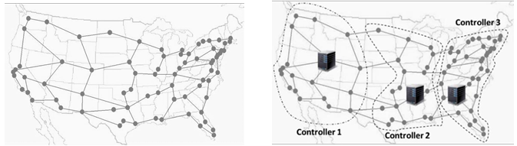
SDN Placement Problem
(1) SDN Controller Placement Problem
(2) SDN Rule Placement Problem
(3) SDN Hypervisor Placement Problem
How many controllers are required
Where to place them
What is the controller domain (switches controlled by each controller)

Slide 27
SDN Rule Placement Problem
• Different types of rules: access control, routing policy, traffic shaping, or traffic engineering rules such as rules for load balancing
• Real-time decision
• How to handle rule conflicts or policies
• Flow rules installed in a reactive, proactive, or hybrid way

Slide 28
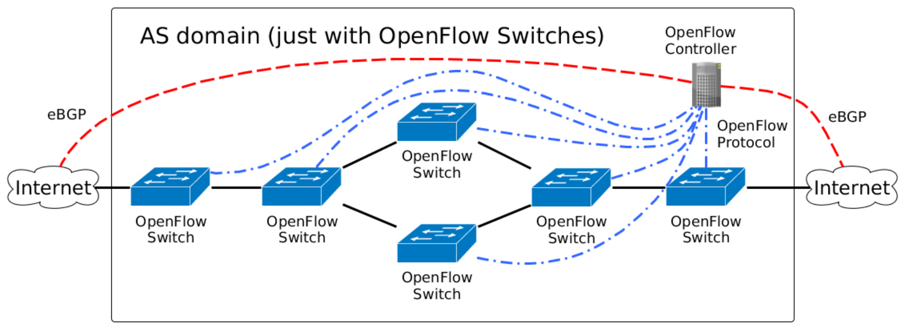

Slide 29
Questions
How many controllers are required to cover a network?
What is the best placement position for each SDN Controller?
What is the cost of each controller?
What should be the capacity of each controller?
How to manage multiple SDN Controllers in the same network?
What should be the capacity of each controller?
How to manage the rules and network policies in a centralised way?
How to deploy virtualised SDN Controllers?

Slide 30
1. How many controllers are required to cover a network?
Depends on network size, topology, traffic load, and fault-tolerance requirements.
Usually:
Small networks → 1 controller is enough.
Medium to large networks → multiple controllers for scalability and redundancy.
Rule of thumb: At least 2 (primary + backup) for high availability.

Slide 31
2. What is the best placement position for each SDN Controller?
Place controllers to minimize latency between switches and controllers.
Use controller placement algorithms (like k-median, k-center).
Typically:
Distributed, near network core.
Close to high-traffic regions.
Controllers should be geographically redundant (different sites) for resilience.

Slide 32
3. What is the cost of each controller?
Cost depends on type and deployment model:
Open-source controllers (ONOS, OpenDaylight, Ryu, Floodlight) → software is free, cost is mainly servers.
Commercial controllers (VMware NSX, Cisco APIC, HP VAN SDN) → license + hardware costs.
Hardware: standard servers or cloud VMs.
Typical cost factors: CPU, RAM, network capacity, license, support.

Slide 33
4. What should be the capacity of each controller?
Capacity = number of switches + flow rules it can handle.
Example (rough guidelines):
Commodity server with 8–16 cores, 32–64 GB RAM → can manage hundreds of switches.
High-performance clusters can manage thousands of switches & millions of flows.
Capacity planning must consider failover (backup should handle full load if primary fails).

Slide 34
5. How to manage multiple SDN Controllers in the same network?
Use controller clustering (ONOS, OpenDaylight) for distributed control.
Controllers share state and topology information.
East-West interfaces allow synchronization.
Load-balancing between controllers ensures scalability.

Slide 35
6. How to manage the rules and network policies in a centralised way?
Use a centralized policy engine on top of controllers.
Example:
Intent-based networking (ONOS Intent Framework, OpenDaylight’s group-based policy).
Northbound APIs (REST, gRPC) for applications.
Policies defined centrally → translated into flow rules by the controller.

Slide 36
7. How to deploy virtualised SDN Controllers?
Controllers can run on VMs, containers, or cloud instances.
Options:
VMware/VirtualBox for labs.
Docker/Kubernetes for production (containerized controllers).
Public cloud (AWS, Azure, GCP) for elasticity.
Virtualization provides scalability, easy migration, and cost savings.

Slide 37
https://next.nutanix.com/community-blog-154/integrating-contrail-sdn-controller-to-man
https://xrdocs.io/design/blogs/latest-cisco-sdn-controllersage-overlay-networks-in-an-ahv-cluster-37936
Must see.
https://www.cisco.com/c/en/us/products/collateral/cloud-systems-management/application-policy-infrastructure-controller-apic/datasheet-c78-739715.html

